Slide 1
deBroglie “Matter Waves”
deBroglie and his matter waves, and its consequences for physics and our concept of reality
Notes:
De Broglie late in his aristrocratic career decided to study physics and he wrote a doctoral thesis trying to get a more reasonable picture for Bohr. De Broglie went back to an earlier notion that discreteness came from waves – like the modes of a string – so he wondered if electrons in atoms had anything to do with the waves of a string

Slide 2
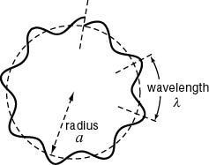
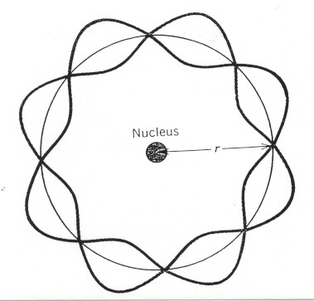
Why quantization of angular momentum?
an integer number of wavelengths fits into the circular orbit
where
l is the de Broglie wavelength
Notes:
And he realized something very simple. If the electron were a wave (or had wave-like character) and the allowed orbits were standing waves of the electrons in a circle. Then Bohrs condition of angular momentum quantization states that the wave-length of the electron must be related to its momentum. Incidentally it is the same relation for photons.

Slide 3
Magnitudes of deBroglie wavelengths
Particle
Value of l_{dB}
Electrons of kinetic energy
1 eV 100 eV 10000 eV
12.2 Å 1.2 Å 0.12 Å
Protons of kinetic energy
1 keV 1 MeV 1 GeV
0.009 Å 28.6 fm 0.73 fm
Thermal neutrons (300K)
1.5 Å
Neutrons of kinetic energy 10 MeV
9.0 fm
He atoms at 300K
0.75 Å
you, walking to the student union for lunch at 2 miles per hour
$$1 Å={10}^{−10}meters$$
$$1 fm={10}^{−15}meters={10}^{−5}Å$$
Notes:
So what is this length-scale that we are talking about – really small for even the smallest things……But we have measured this scale before – anyone remember when? Diffraction!!

Slide 4
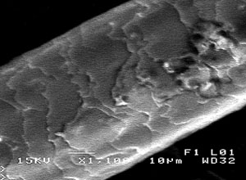
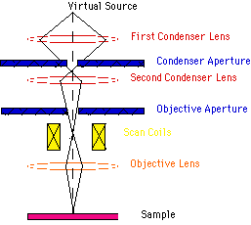
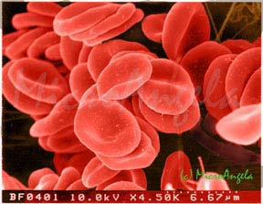
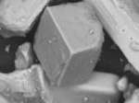
Scanning Electron Microscope
Human hair
Table Salt
Red Blood Cells

Slide 5
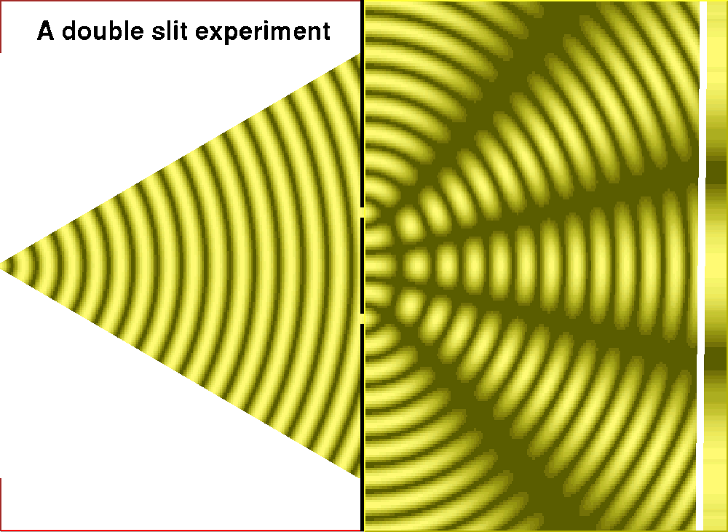
the realization that matter
has wavelike properties

Slide 6
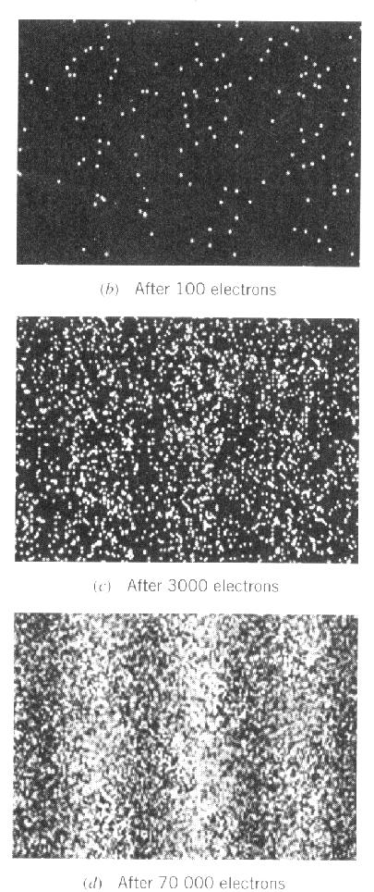
Wave Properties of Electrons
Transmission Electron Microscope
Electrons passed through two slits and detected
http://www.hitachi.com/rd/portal/highlight/quantum/doubleslit/index.html

Slide 7
What does it mean?
A large number of electrons going through a double slit will produce an interference pattern, like a wave.
However, each electron makes a single impact on a phosphorescent screen-like a particle.
Electrons have indivisible (as far as we know) mass and electric charge, so if you suddenly closed one of the slits, you couldn’t chop the electron in half-because it clearly is a particle.
A large number of electrons fired at two simultaneously open slits, however, will eventually, once you have enough statistics, form an intereference pattern. Their cumulative impact is wavelike.
This leads us to believe that the behavior of electrons is governed by probabilistic laws. --The wavefunction describes the probability that an electron will be found in a particular location.
(see animation https://www.youtube.com/watch?v=Xmq_FJd1oUQ)

Slide 8
We are about to embark on a wave theory of matter …
It is a good idea to review some concepts about waves

Slide 9
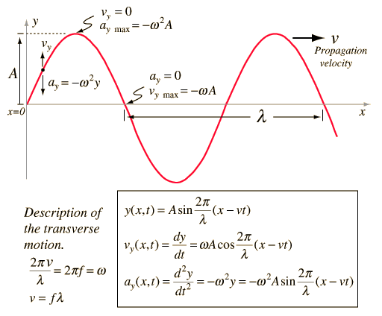
Anatomy of a classical travelling wave
For example:
Wave on a string
Snapshot at some time t

Slide 10
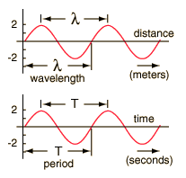
Anatomy of a classical travelling wave
$$y\left(x,t=t_{0}\right)$$
Fixed time (snapshot)
$$x$$
$$y\left(x=x_{0},t\right)$$
Fixed location
$$t$$
$$y\left(x,t\right)=A\sin\left[\frac{2π}{λ}\left(x−vt\right)\right]$$
Wavenumber:
$$k≡\frac{2π}{λ}$$
All harmonic waves satisfy:
$$fλ=v$$
$$f=v/λ$$
so
$$2πf=ω=\frac{2πv}{λ}=kv$$
Hence
$$y\left(x,t\right)=A\sin\left(kx−ωt\right)$$

Slide 11
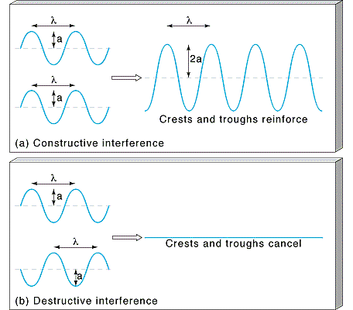
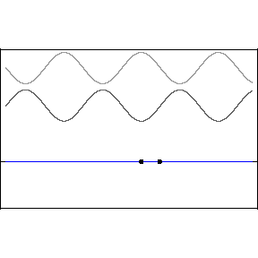
Interference
waves can interfere (add or cancel)
Two solutions to a linear wave equation:
$y_{1}\left(x,t\right)$, $y_{2}\left(x,t\right)$
Any linear combination is also a solution
to the wave equation:
$${y_{super}\left(x,t\right)=ay}_{1}\left(x,t\right)+by_{2}\left(x,t\right)$$

Slide 12
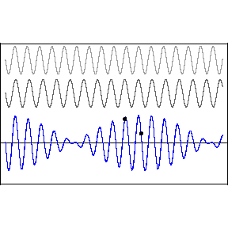
Interefering waves, generally…
“Beats” occur when you add two waves of slightly different frequency. They will interfere constructively in some areas and destructively in others.
Can be interpreted as a sinusoidal envelope:
Modulating a high frequency wave within the envelope:

